Slide 1
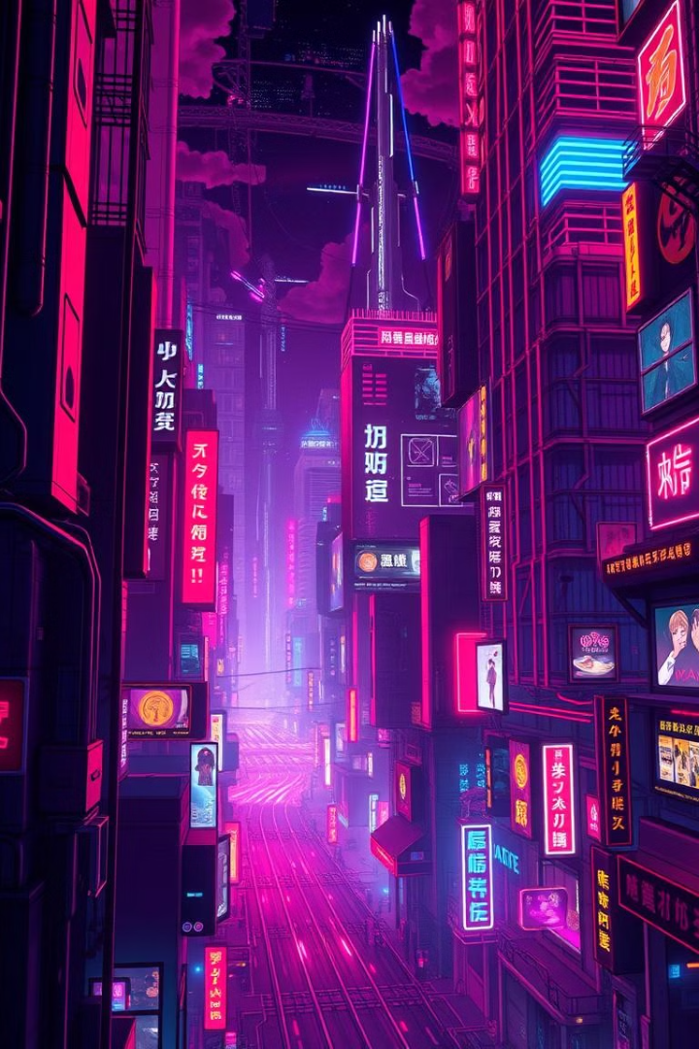

Animeverse: Revolutionizing Anime Creation with AI
Welcome to Animeverse, the innovative platform that's set to transform the world of anime creation! We're harnessing the power of AI to make anime character development and animation accessible to everyone.
by HackStorm

Slide 2
Meet the Innovative Team Behind Animeverse
Garima
Ayushi
Vanshdeep
Dhanu Shree
Visionary leader, driving force behind the Animeverse concept.
Technical expert, ensuring seamless AI integration and app functionality.
Creative genius, leading the design and animation aspects of Animeverse.
Project Lead

Slide 3
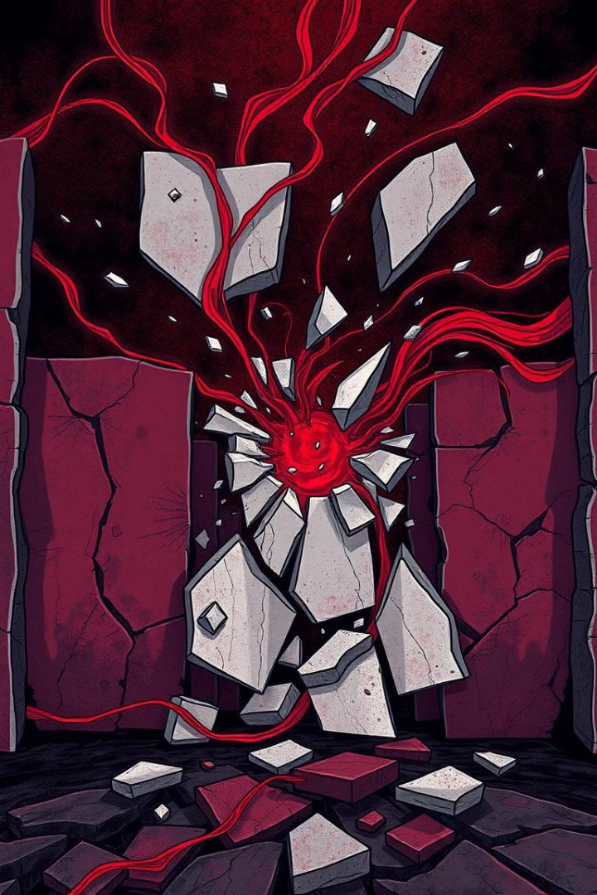
Addressing Barriers with AI-Powered Creation
1
Problem: Limited Resources
2
Solution: AI-Powered Platform
Traditional anime creation requires extensive time, skills, and resources.
Animeverse democratizes access to anime character development, simplifying the process.
3
New Avenues
Unleash creativity and explore new artistic avenues, without the need for traditional skills.

Slide 4
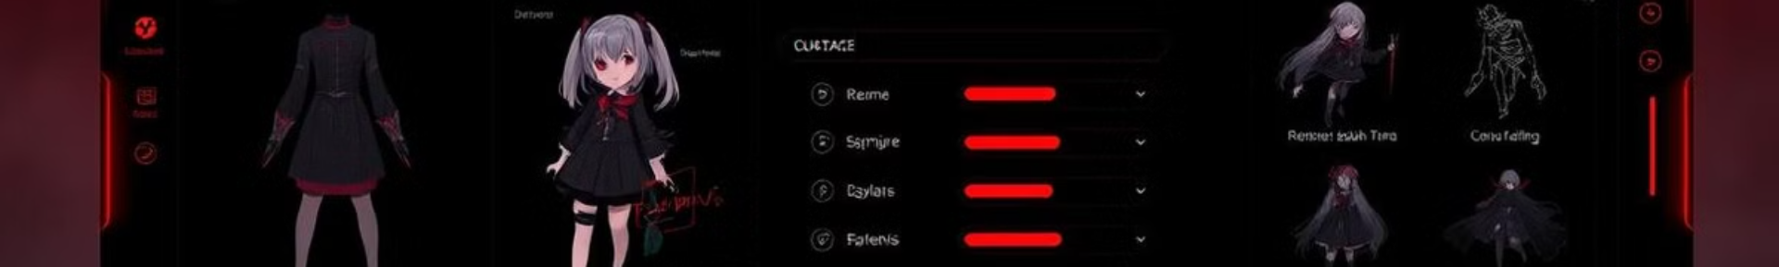




AI-Driven Character Design: Step-by-Step
Input Desired Traits
Describe your dream character: appearance, personality, style.
AI Generates Options
Our AI provides a range of character designs based on your input.
Customize and Refine
Fine-tune every detail to match your vision, from hair to clothing.
Perfected Character
A unique anime character, ready for voice integration and animation.

Slide 5




Voice Integration: Breathing Life into Characters
Voice Input
Voice Customization
Lip Sync Tech
Record your own voice or select from various AI-generated voices.
Adjust pitch, tone, and accent to perfectly match your character's personality.
Animeverse seamlessly syncs voices with character animations for a natural feel.

Slide 6




Motion Animation: Static to Dynamic in Minutes
Import Character
1
Choose Style
2
4
Export
3
Animate
Transform static characters into dynamic animations with ease. Select from a library of animation styles or create your own unique movements, and bring your anime visions to life.

Slide 7
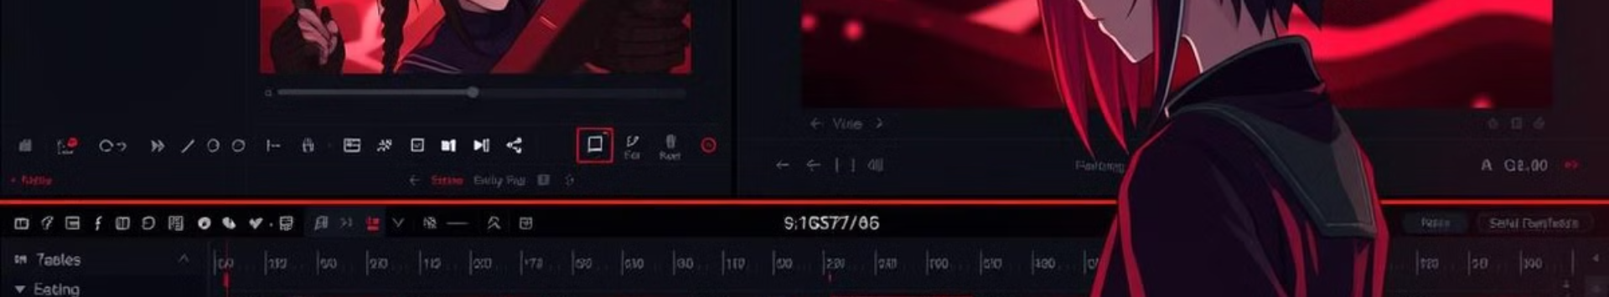
Advanced Editing: Unleash the Power of Customization
Timeline Editing
Visual Effects
Sound Design
Precise control over every frame, ensuring seamless animation sequences.
Add stunning effects: lighting, shadows, particles, and more, to create a unique visual experience.
Perfect the audio with music, sound effects, and voice enhancements.

Slide 8



User Experience: A Simple Interface for Everyone
Intuitive
1
Simple, understandable
Elegant
2
Aesthetically Pleasing
Seamless
3
Fluid Work Flow
Our User Experience is the cornerstone of our platform, carefully constructed to be intuitive, elegant, and seamless.

Slide 9
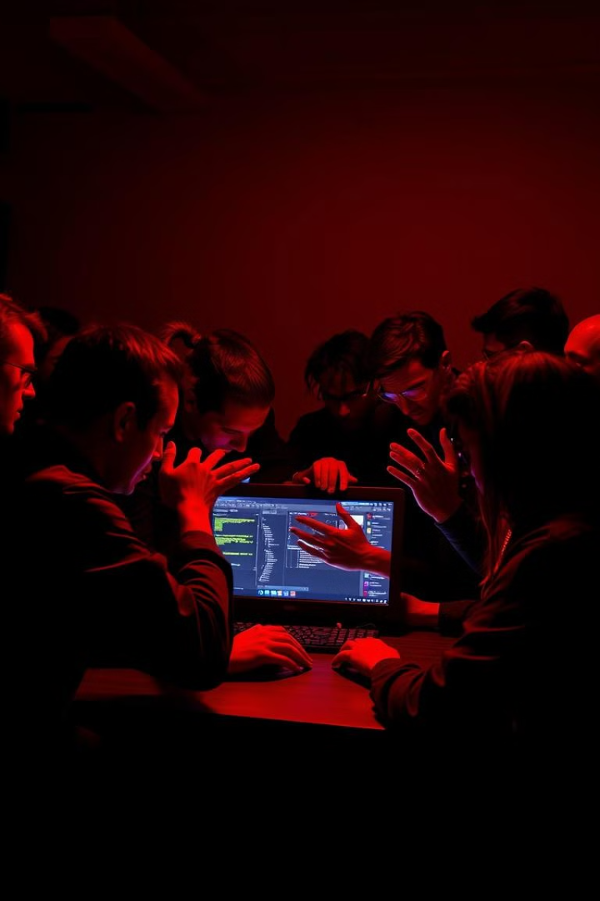
Feedback: Driving Improvement Together
1
In-App Feedback
Users can easily share their thoughts and suggestions directly within the app.
2
Community Forums
Engage with fellow creators to share ideas and provide support.
3
Regular Updates
Animeverse will evolve with user feedback, incorporating new features.

Slide 10
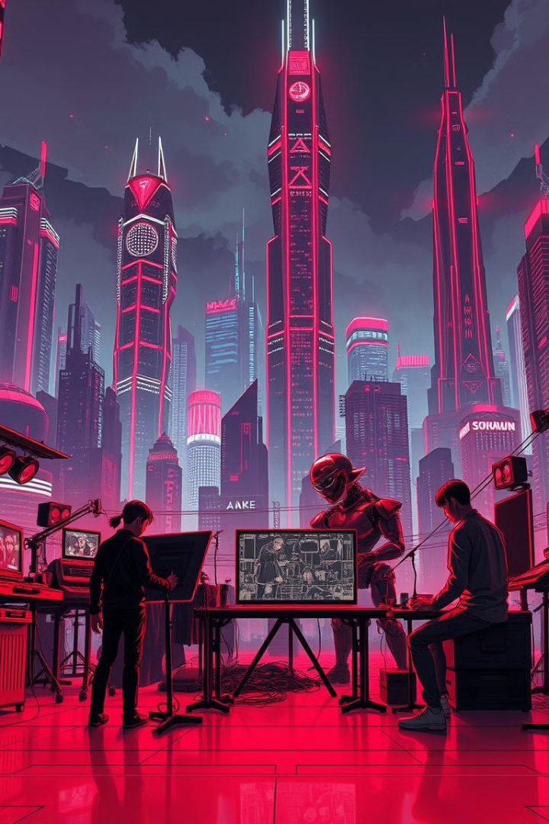
Future Vision: Transforming the Entertainment Landscape
∞
1
Endless Possibilities
Revolutionize
AI
New Standard
Animeverse will empower creators. By democratizing anime creation we unlock limitless potential within the industry and usher in a new era of storytelling.

